Slide 1
BECOMING A LADY OF WORTH
Prepared by:
Patricia Clarke

Slide 2
Objectives
This presentation is intended to:
1. Differentiate between a lady and a woman.
2. Demonstrate the characteristics of a lady.
3. Highlight the importance of cultivating lady-like attributes

Slide 3
WHO IS A LADY?
ARE ALL WOMEN LADIES?

Slide 4
A lady is a woman who displays self-respect, class, appreciation, and etiquette. She does not allow her mood to affect her manners. It doesn’t mean that she should be snobby or stuck up, but that she should have dignity, consideration, and moderation in her daily actions.

Slide 5
From a biblical perspective, we can make a lady synonymous to a Godly woman , one who controls her thoughts, taking them captive and making them obedient to Christ. She controls her emotions and doesn’t allow them to control her.

Slide 6
WHAT MAKES A WOMAN A LADY ?

Slide 7
Characteristics of a lady?
A lady refrains from using VULGAR LANGUAGE because she understands that the language she uses represents her mind and heart.
This means:
We do not shout across the room, the block for any reason
We speak with respect to everyone and at all times (no indecent language)

Slide 8
2. A lady dresses tastefully. ( Expensive does not equal tasteful)
It means she knows how to put ourselves together in accordance to occasion, expectations and time.
It also means that even under garments should be carefully selected at all times.

Slide 9
3. A lady is not PETTY – this means that a lady will:
Try to resolve problems amicably
Ignores certain comments
She will not show jealousy over others
Ultimately, she will not argue over every thing: will be a peacemaker

Slide 10
4. A lady possesses a strong work ethic. This means that:
She will put effort in ensuring she is at school/classes on time
She will endeavour to meet her deadlines
C. She will be considerate about the other’s time.
D. She will remain possible in the face of difficulties

Slide 11
5. A lady is poised, graceful, and confident.
Her posture and body language communicate a strong personal presence.
She exhumes a level of confidence and self-worth that commands respect. The type that will dictate how she is treated by – friends, teachers, acquaintances and most importantly- the opposite sex.

Slide 12
6. A lady respects authority. This means that:
a. She will follow rules and guidelines regardless of personal preferences
b. She will guard the way she speaks to her superiors
c. She will not find excuses for inappropriate behaviour

Slide 13
7. A lady is a lifelong learner. She is always trying to improve herself because she understands that:
a. Her worldview highly dictate how she acts, reacts and present herself in society.
b. There are social etiquettes or guidelines that govern all aspects of life

Slide 14
8. A lady chooses her company carefully.
She understands that she writes her own narrative, and her friendships reflect who she is at her core.

Slide 15
9. A lady is honest and have integrity. This means:
She does not tell unnecessary lies
She does what is expected – even if she has to do it alone

Slide 16
10. A lady is always prepared. Life does not just happen to her.
SHE IS PREPAPRED FOR EVERY FACET OF HER LIFE.

Slide 17
WHY SHOULD YOU CULTIVATE LADY-LIKE ATTRIBUTES?

Slide 18
a. Ferncourt High School, your current home and your communities are your training grounds.
b. You must be cognizant of the fact that the future will not and cannot be delayed. the only question is,
“ How will you show up for that future?”

Slide 19
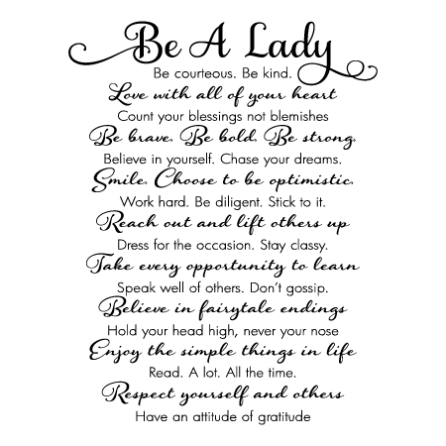

Slide 20
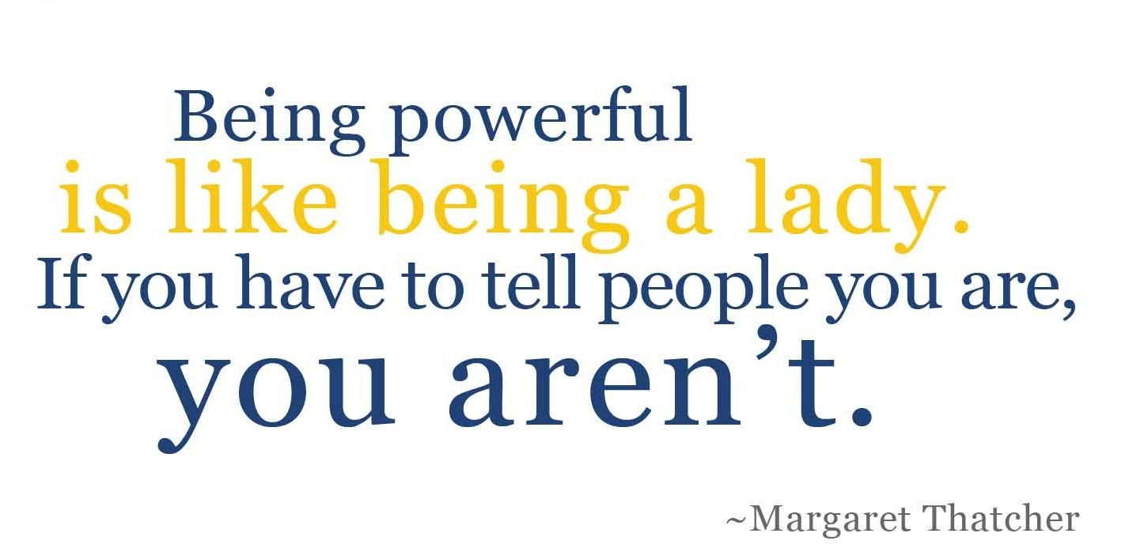

Slide 21
